Slide 1
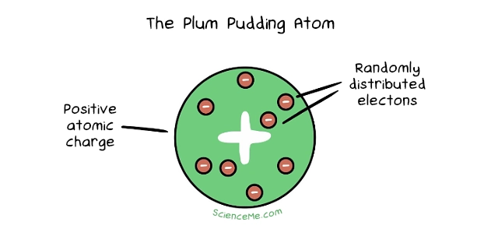
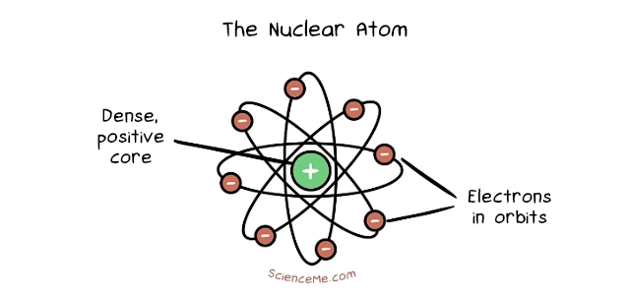
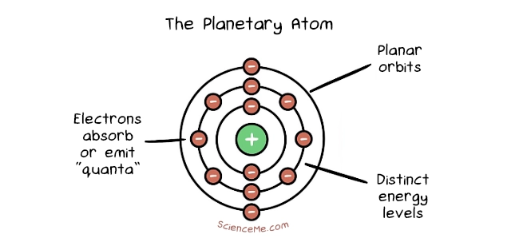
Convergence in ethics: a modelling view
Joe Roussos
Stockholm University
Notes:
I am a philosopher of science, who has recently taken an interest in meta-philosophy. I am interested in whether philosophers can, do and should engage in modelling. I started by thinking about epistemology, but now I am applying this idea to ethics. That informs the talk you’re about to hear. I’m an outsider to meta-ethics and normative ethics, offering a methodological perspective based on some more general meta-philosophical ideas.

Slide 2
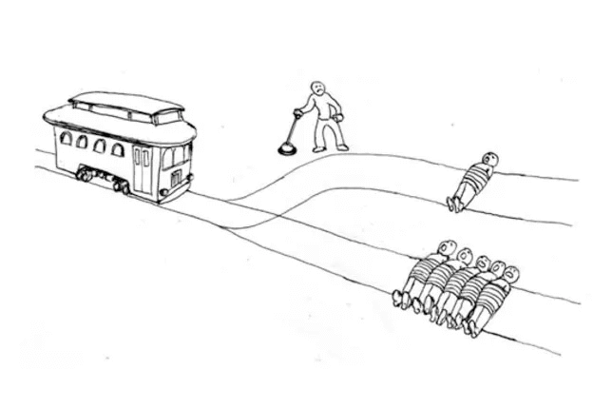
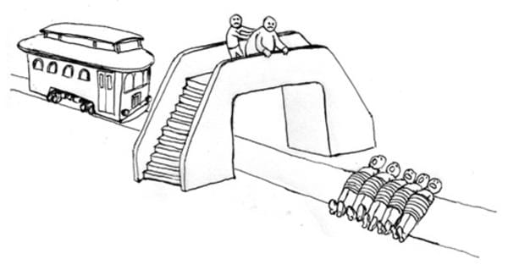
Disagreement
Hard cases
Focus on explanatory structures, e.g., rightmakers
Notes:
A major topic of concern in meta-ethics is disagreement. This is often framed as persistent disagreement between people: moral philosophers, who have thought long and hard about the issues. This concern makes sense. It is the result of two methodological tendencies:
A methodological focus on hard cases, which draw apart the different theories and force choices upon theorists
A focus on reasons/explanations. Put another way, a lot of the action in ethical theorising is on the rightmakers, rather than the verdicts of rightness

Slide 3
Agreement
Utilitarianism
Kantianism
Contractualism
Underlying agreement
Principlism in bioethics
Convergence over time
Notes:
Another trend in recent work focuses on agreement
Parfit, in On What Matters, is interested in drawing out ways in which the seemingly different ethical theories may be compatible. This is in part because, he asserts, they are doing different work, and in part because there are unrecognized ways of arguing from one to another.
Principlism in bioethics: most moral theories recommend a set of mid-level principles: respect for autonomy, beneficence, non-maleficence, justice. This recommends these principles as tools for applied ethical reasoning
Tersman: are ethical theories moving closer over time, in response to challenging new cases in population ethics? This is good!

Slide 4
What is the epistemic significance of agreement in ethics?
?
?
cf. Kappell et al. 2025

Slide 5
Plan
1. Models in ethics
3. Derivational Robustness
5. Stability under perturbation
2. Convergence in the modelling view
4. Independent Assumptions

Slide 6
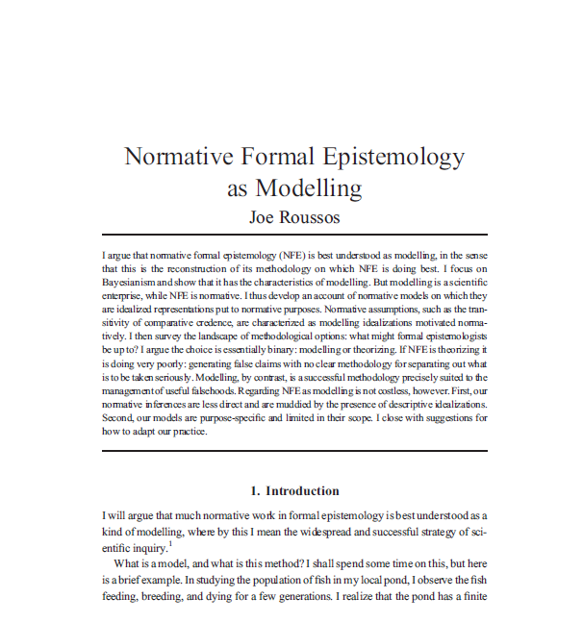
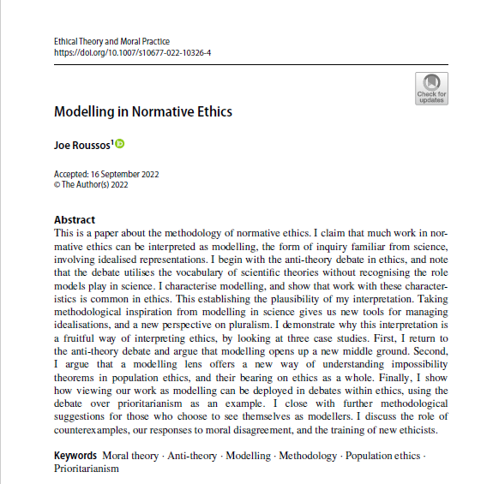
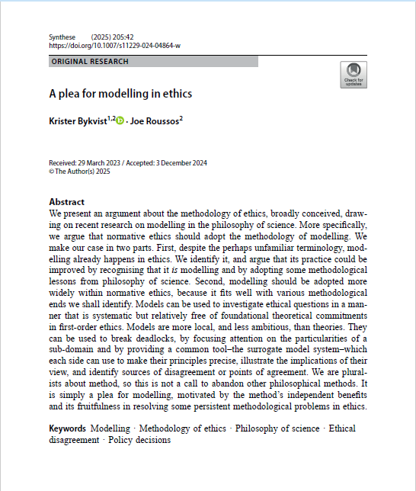
My approach: ethical theories →models
What does my view of ethics as modelling have to say about the epistemic significance of convergence?
// model robustness and confirmation
Notes:
I have developed a view on which philosophers can and do use the method of modelling familiar from the sciences. I started with epistemology, but in a series of recent papers have focussed on ethics.
Roughly speaking, I propose to reinterpret familiar ethical frameworks as models, rather than theories
Now the question is: what does this view have to say about convergence in ethics?
The question arises naturally because there is a lot of focus on convergence between models in science. There is a whole philosophy of science literature devoted to studying techniques which try to extract epistemic significance from agreement between models. Core idea: convergence gives an epistemic BOOST

Slide 7

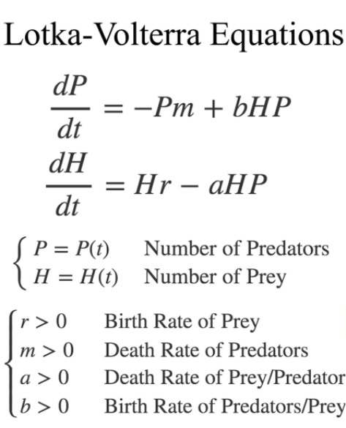

What is a model?
Ex 1: Molecular model
Ex 2: Lotka-Volterra model
This Photo by Unknown Author is licensed under CC BY
Notes:
Molecular modelling kit, from highschool chemisty.
Using balls and rods, you construct a model of a particular molecule. You might connect 2 black balls and 1 red ball with short rods, forming a V shape. This is a model of H2O.
This is a physical object. Familiar from ”scale models” of trains. In this case, used in the study of molecules, highlighting their composition and structure
2. Lotka-Volterra model: a set of differential equations, used to describe the dynamics of biological systems in which two species interact, one as a predator and the other as prey.
Used by Vito Volterra to explain changes in the composition and dynamics of fish populations in the Adriatic Sea.
This is an abstract object. Described by mathematical equations. There is no physical object representing those populations. Rather they are represented by mathematical variables in relationships described by the equations

Slide 8






Modeling elements
Target
The thing you are trying to model
Purpose
What you want to achieve, why you are modeling
Representational device
What you use to represent the target
Idealizations
Distortions, abstractions, structural assumptions
Scope
Given the purpose and idealizations, what is this model good for
Notes:
Let’s just quickly review the elements of scientific modeling using the example of this model of caffeine
Target: actual caffeine molecules
Purpose: synthesize caffeine.
Representational device: balls and rods of the MolyMod system
Idealizations: ignore size and colour. World is complex, we must focus. Motivated by the purpose
Scope: what is this model good for? Determined by compromize between purpose and idealization
E.g., studying chemical structure.
You can’t use this model to study the size and colour of molecules.
You derive the scope by considering the purpose of the model, the idealizations you made and why you made them, and the resulting constraints they provide

Slide 9

Models in ethics
Target
Part of the moral domain, e.g., right action
Purpose
$$RM(A,C)↦ R(A)$$
Determine and explain right action
Representational device
e.g., utilitarian calculus, Parfit’s box diagrams
Idealizations
”Other things equal”, utility is cardinally measurable
Scope
Utilitarianism as Government House ethics
Notes:
Basic idea, with utilitarianism as a working example
Target: domain of right action
Purpose: derive and explain right action. I am thinking of models of right action, with the structure rightmakers → right action. Agreement is at the level of right action. Famously, ethical theories/models disagree on rightmakers)
Representational device: abstract system, acts, states, consequences, utilities
Idealizations: Goodness is cardinally measurable, rightness doesn’t involve anything that doesn’t resude to goodness of outcomes
Domain: Controversial. I would say: large-scale social ethics, many people. i.e., Government House ethics.
This is its ”home turf”
Some theorists tell you the domain!
Scanlon: this is interpersonal ethics
Sen: model of freedom in social choice
This picture should be meta-ethically neutral. If realist: model populated with data about normative facts. If non-cognitivist, model helps you systematize your connative attitudes towards particular situations, within a domain. Same ”data” – different phenomena.

Slide 10
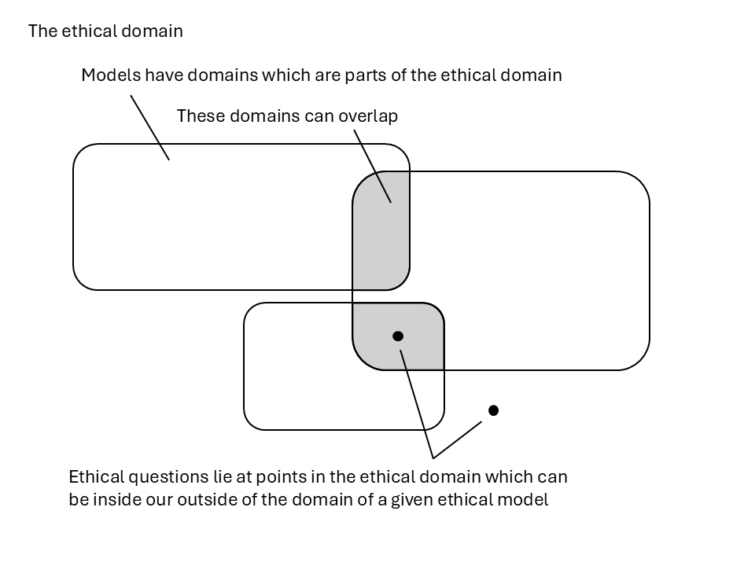
Notes:
So far, what tools do we have to think about convergence?
The significance of agreement depends on our view of the models’ natural domains
3 cases
Issue in both domains
Issue in one domain
Issue in neither domain
Models can work outside of their domains. Domain = home turf. But we shouldn’t expect too much of it outside of its home domain
e.g., Utilitarianism is a model of large-scale social ethics. It can be used to generate judgements about friendships, but this lies in the domain of small-scale personal ethics. We should expect less of it here. The agreement between, say, U and K on issues of friendship should be assessed in the context of these facts about their purposes and domains.

Slide 11
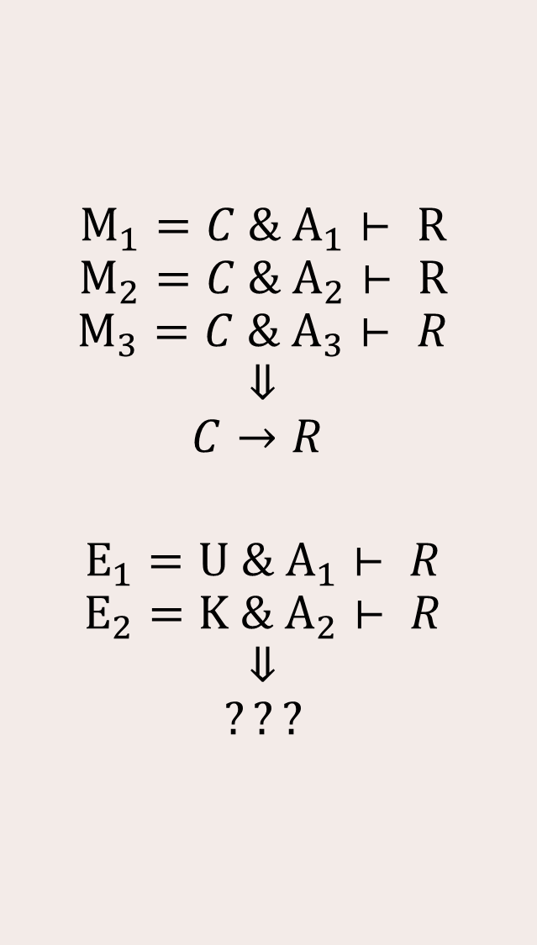
Derivational Robustness
$$M_{1}=C \& A_{1}⊢ R$$
$$M_{2}=C \& A_{2}⊢ R$$
$$M_{3}=C \& A_{3}⊢ R$$
$$⇓$$
$$C→R$$
$$E_{1}=U \& A_{1}⊢ R$$
$$E_{2}=K \& A_{2}⊢ R$$
$$⇓$$
$$???$$
Different routes to deriving the same result provide epistemic robustness
“A result is said to be derivationally robust if it can be derived from several sets of assumptions.” (Lehtinen 2016)
Notes:
In science: common approach is to look for models with common core elements, which are thought to describe the causal structure of the target system. E.g., different kinds of mathematical structures, different equations, which capture the same dependency relation as the Lotka-Volterra equations.
Reasoning: each model pairs the core with different assumptions (e.g., structural assumptions). They get the same result. Conclusion. C leads to R, and that will hold in the real world.
Problem: our starting point in ethics is that the explanatory structure is different. Util and Kant propose different rightmakers. So we can’t infer anything about a common core leading to R, unless we posit some deep structure which is the same across them.
Instead, we want to know whether R is made more likely

Slide 12
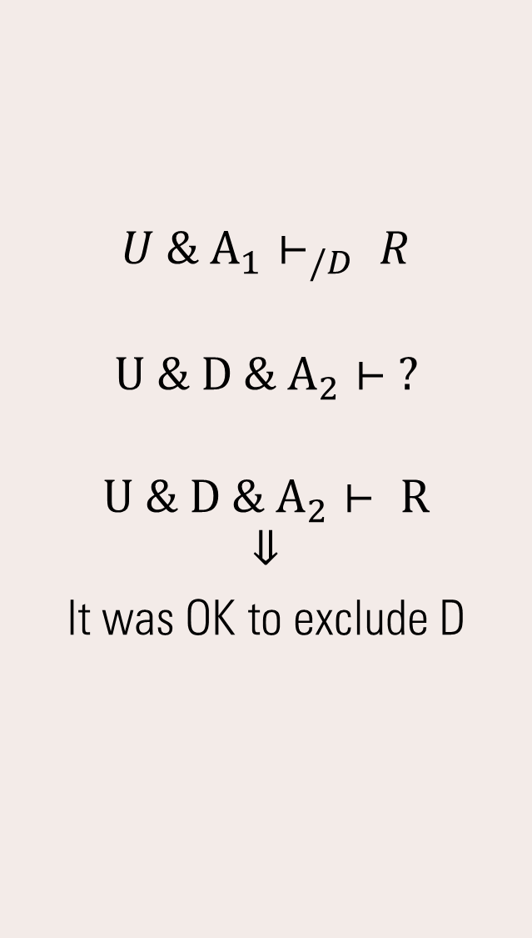
Independence of tractability assumptions
$$U \& A_{1}⊢_{/D} R$$
$$U \& D \& A_{2}⊢ ?$$
$$U \& D \& A_{2}⊢ R$$
$$⇓$$
It was OK to exclude D
Aside
(Kuorikoski et al. 2010)
Limited case might still be useful
Consider ”other things being equal” cases in ethics
e.g., a welfarist model which assumes other contributors to rightness are held equal
Concern: can these other factors be held equal? What if the answer changes?
Notes:
Utilitarian assumptions, plus some other structural assumptions, gets us a result (factoring our other considerations, such as desert)
Now what happens if we add in desert?
We build a new model, it includes desert, we get the same result.
This establishes that it was ok to exclude desert in the first place. We can go back to using the simpler model, which may be much easier to work with

Slide 13
Perturbation invariance
Space of model structures
General idea: imagine a space of potential models. Points in the space a different structures of rightmakers, for example
Draw a boundary around all the models we have. The right structure is somewhere in this area
Look at results which are invariant across this area
No matter which structure in this area is right, the following result holds
Result space
Problem: we already knew that
Notes:
Conclusion: this uncertainty doesn’t matter for this result

Slide 14
Conclusion
The conditions under which model robustness is epistemically significant don’t seem to support the significance of convergence in ethics
There are resources for thinking about which kinds of convergence are better candidates for significance
Unclear whether we should see this as a refutation of the significance of convergence or as a problem for the modelling view

